Slide 1


2024
ITCS-GP-GRAD 1
FinFlow: Your Daily Financial Buddy
Supervisors:
Presented By:
Omar ElSayed
Arwa Nader
Mahmoud Youssef
Mohamed Ashraf
Amr Nabil
Khaled Mohamed
Dr. Ahmed Fathy ElNokrashy

Slide 2


Agenda
01 | Background/Problem
02 | Scope
03 | Related Work/Competition
04 | Features & Functionality
05 | Implementation
06 | Future Work

Slide 3


Problem
GenZ and Millenials spend 30-40% of their monthly budget on entertainment, dining out, and technology upgrades
They also spend between $75-100 each month on subscription services (music, video streaming, etc..)
Individuals experiencing financial stress were 2.5 times more likely to report symptoms of anxiety and depression compared to those without financial stress.
Deloitte. (2022). Deloitte Global Millennial and Gen Z Survey. https://www2.deloitte.com/global/en/pages/about-deloitte/articles/millennialsurvey.html
Volkos, P., & Symvoulakis, E. K. (2021). Impact of financial crisis on mental health: A literature review ‘puzzling’findings from several countries. International Journal of Social Psychiatry, 67(7), 907-919. Chicago

Slide 4
Here Comes
FinFlow:
Your Daily Financial Buddy

Slide 5
Objectives and Goals
FinFlow is designed to address the growing need for effective personal finance management tools in today’s fast-paced, digitally driven world
Expense Tracking
Financial Insights
Investment Recommendation
Provide users with an intuitive platform to track daily expenses manually or through automated methods.
Offer detailed visualizations (pie charts, bar graphs) to help users understand their spending patterns.
Provide AI-driven suggestions for investments based on user financial data

Slide 6


Target Market
GenZ
Millenials
Unaware Spending on unnecessary stuff
Eager to save more money in a capitalist world

Slide 7




Historical Perspective
Early Methods
Digital shift
Big Data
AI Revolution
Handwritten records, ledgers, labor-intensive.
Internet and smartphones enabled tools like Mint.
Modern trackers integrate APIs and cloud tech for auto-sync and insights.
Automates categorization, predicts user behavior, and provides personalized recommendations.

Slide 8
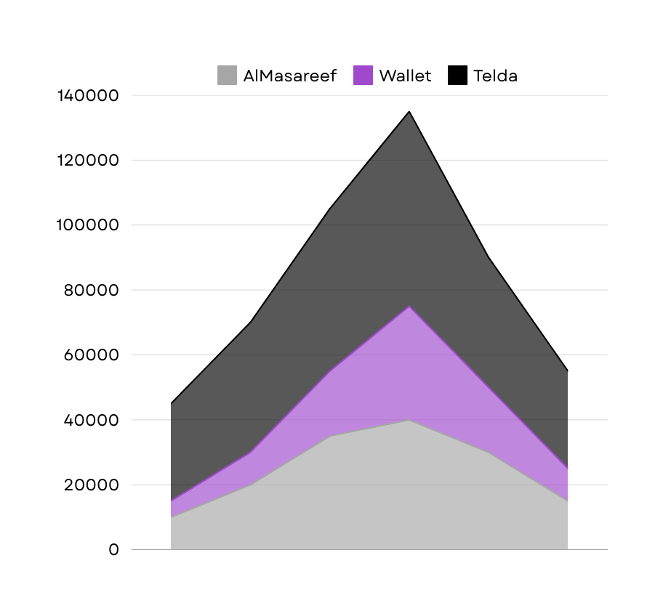
Competition
Telda (Very Popular)
Has the ability to transfer money between contacts
Al Masareef
Has analytics tools to evaluate spending habits, monthly reminders, and the ability to export financial data.
Wallet (Very Popular)
Categorization of expenses, bank synchronization, and visual analytics like pie charts for financial insights.

Slide 9

Stakeholders
Customers (Individuals): Track daily expenses, view and analyze personal financial summary, receive investment or saving recommendations.
Small Business: Monitor operational expenses and revenues, generate basic financial statements and reports, avoid high costs of enterprise-level financial tools.
Financial Advisors: Track and review client expenses to provide better advice, recommend the tool as a supplementary method for clients to manage their personal or small business finances.
Educational Institutions: Use the app as a teaching tool in finance, business, or computer science courses, illustrate practical application of data management, AI (for recommendations), and user experience design.

Slide 10
Scope: Features & Functionality
Expense Tracking: Provide users with an intuitive platform to track daily expenses manually or through automated methods.
Category Management: Enable users to set and monitor monthly or weekly budgets for specific categories.
Frequent Notifications: Alert users when their expenses exceed budget limits or when unusual spending patterns are detected.
Investment Recommendation: Provide AI-driven suggestions for investments based on user financial data.

Slide 11
Scope: User Modes
Individual Mode: Designed for personal use, focusing on daily expense tracking and budget management.
Small Business Mode: Enables small businesses to track operational expenses and optimize budgets.
Financial Advisor Mode: Provides tools for financial advisors to monitor client expenses and offer personalized recommendations.

Slide 12



FinFlow External Interaction
Investment Market Data
For providing real-time data and updates on investment opportunities and market changes.
Authentication Services
For external login or social login using Google, Apple, etc.
Notification Services
Used to send alerts, reminders, and confirmations to users.

Slide 13
Functional Requirements | Non-Functional Requirements
The user should be able to create an account and authenticate with secure credentials | Security: All data must be encrypted at the database level and in transferring the data using HTTPS
The user should be able to add financial data using multiple methods | Performance: Key dashboard pages should load within 2 seconds under normal usage.
The system shall display a dashboard with up-to-date summaries of expenses, income, and savings goals | Portability: The system shall run on major operating systems like Android and IOS
The system shall integrate with external market data APIs to offer basic investment or savings recommendations.
The system shall send notifications for nearing budget limits, bill reminders, etc.. via email, SMS, or push notifications

Slide 14
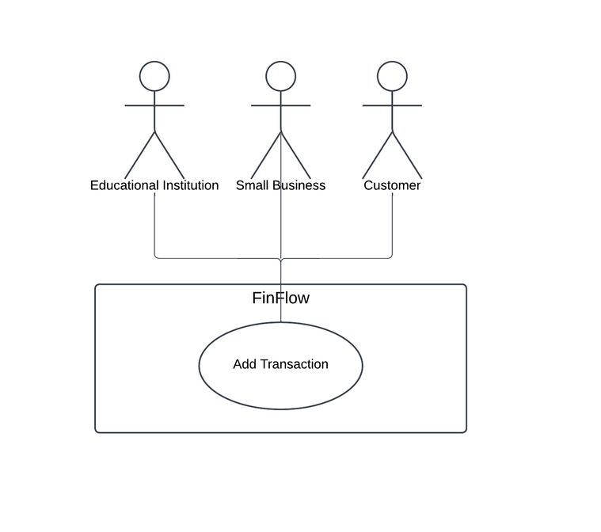
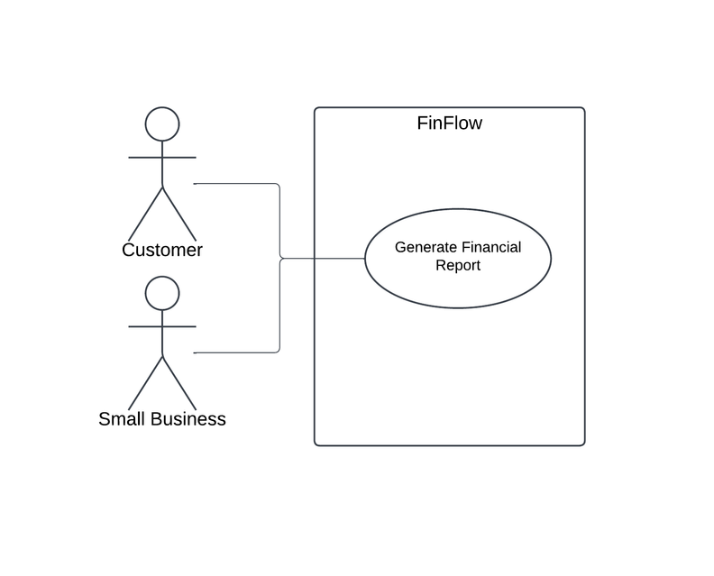
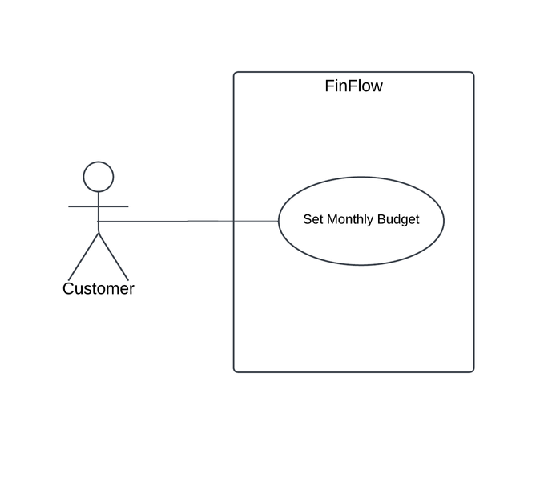
Some Use Cases
UC1: Individuals, Small Businesses, Educational Institutions can add transactions
UC2: Individuals, Small Businesses can generate Financial Reports
UC3: Only Customers can set Monthly Budgets

Slide 15



Implementation: Languages & Frameworks
Flutter
Selected for frontend development due to its rich widget library and ability to deliver a native-like experience on both IOS and Android.
Dart
The primary language for the frontend development using the Flutter framework.
FireBase
Used for real-time database management, authentication, and push notifications. Firebase was selected for its scalability and free service.

Slide 16
FinFlow
App Overview!

Slide 17
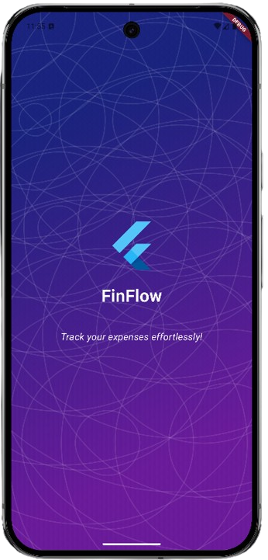
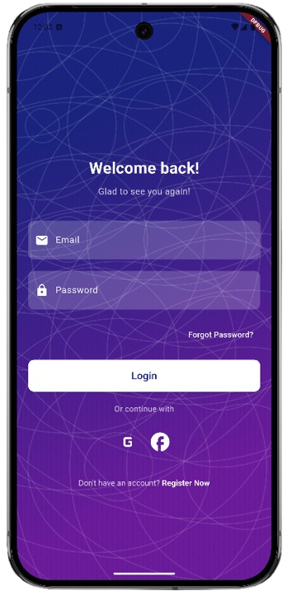
User
Login
Log In Screen
Splash
Screen

Slide 18
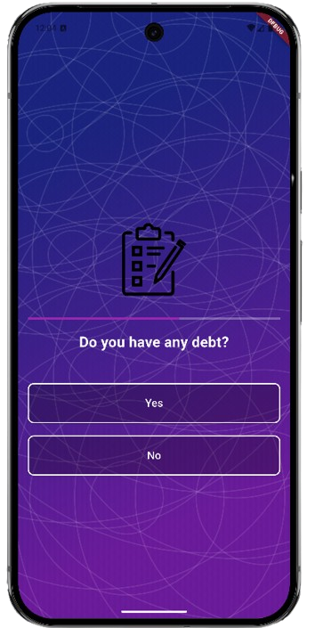
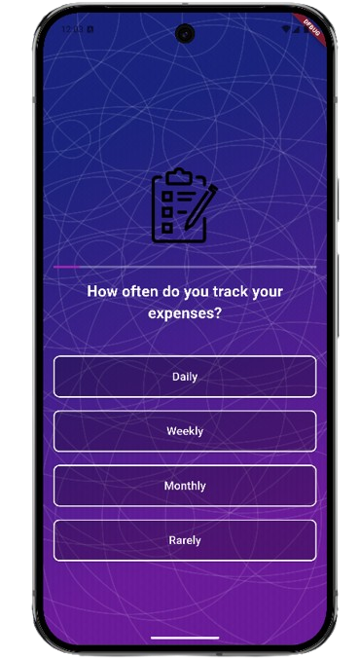
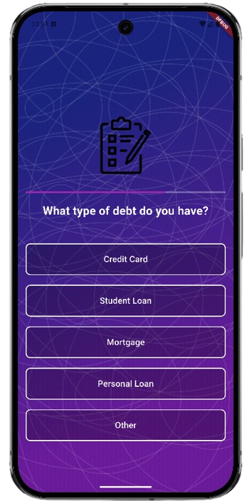
User
Survey
What are your Financial Goals?
How often do you track your expenses?
What type of debt do you have?

Slide 19
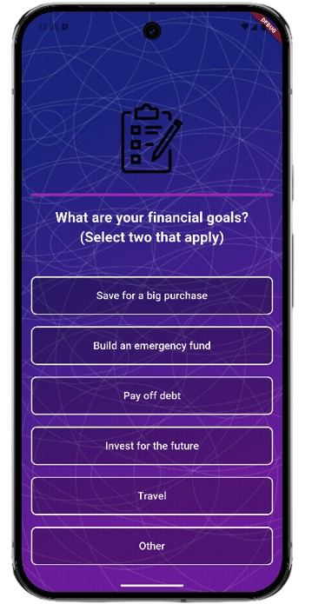
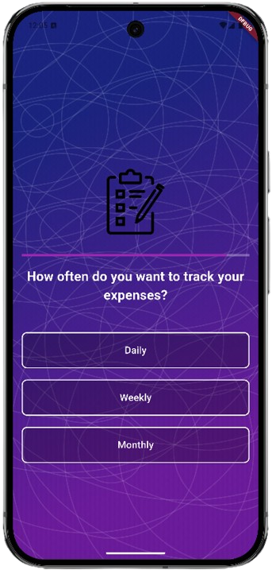
User
Survey
Questions that decides the User’s Monthly Plan!

Slide 20
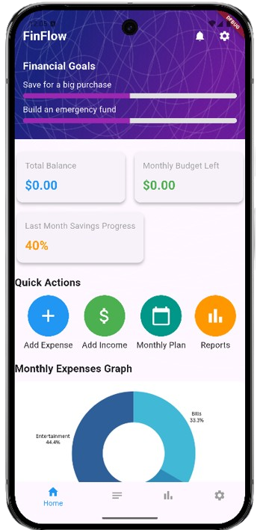
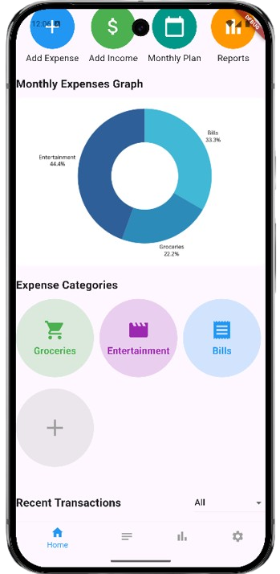
Home
Screen
Organized UI for friendly and simple use!

Slide 21
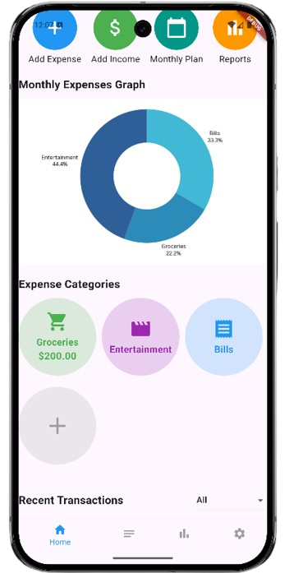
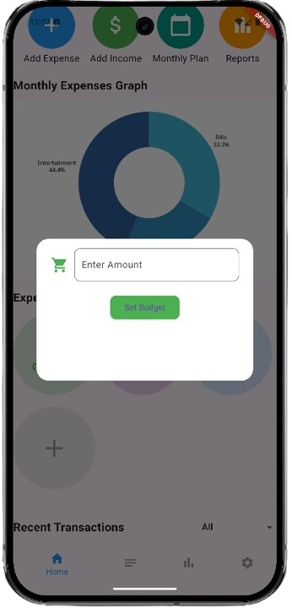
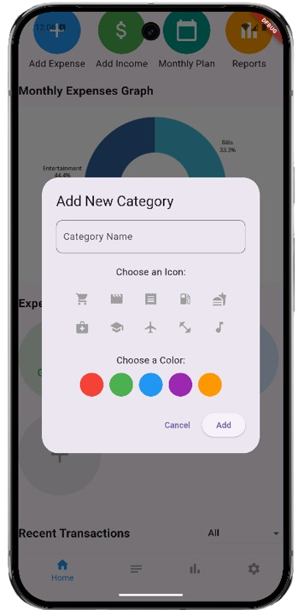
Categories
Categories make the app more intuitive and organized..

Slide 22
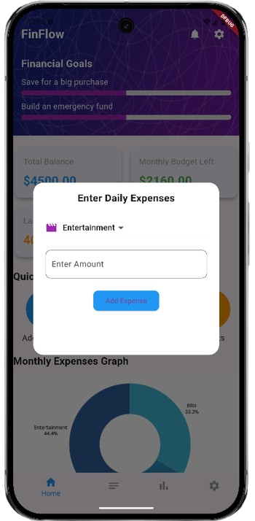
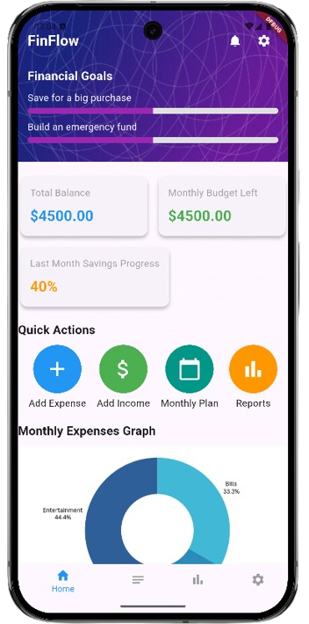
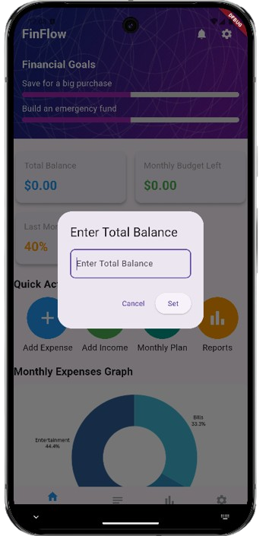
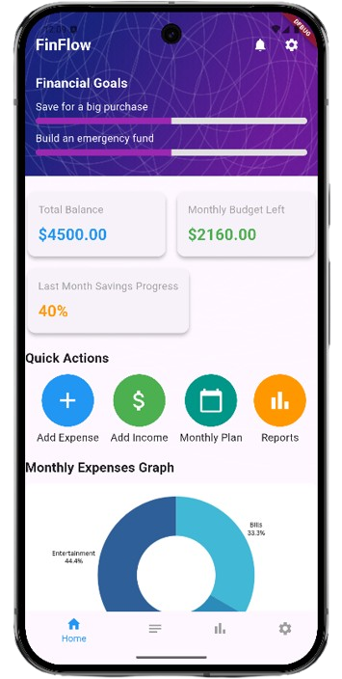
Daily/Monthly
Budget/Expenses
Enter your total Monthly Budget
Enter your Daily Expenses

Slide 23
Introducing

Slide 24
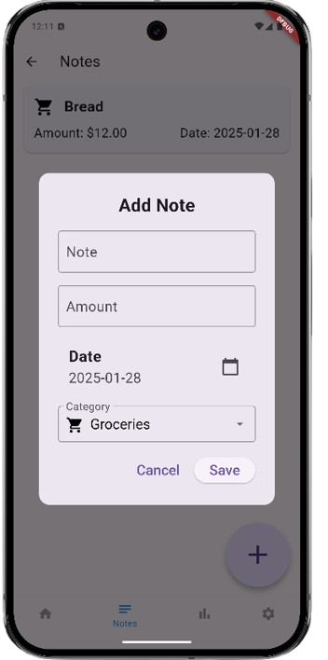
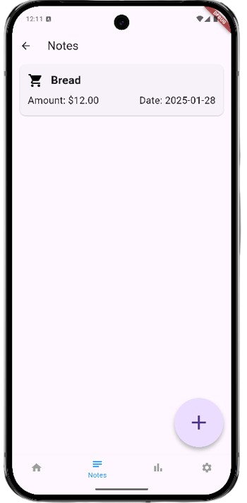
Notes!
Built-in Notes system to remind you of your planned purchases!
No Need to use a separate notes App!

Slide 25
Future Work
Make predictions: based on the financial activity of the month (time span: 1,3,6 month)
User budget: analysis over the last 6 months and graphs show monthly expenses analyzing expenses over the last 6 months and display them in a pie chart or graph
Business or personal: for user’s need and Business Needs, targeting start ups, to mange their budgets.
Investments: give suggestions for the user to invest in profitable business

Slide 26
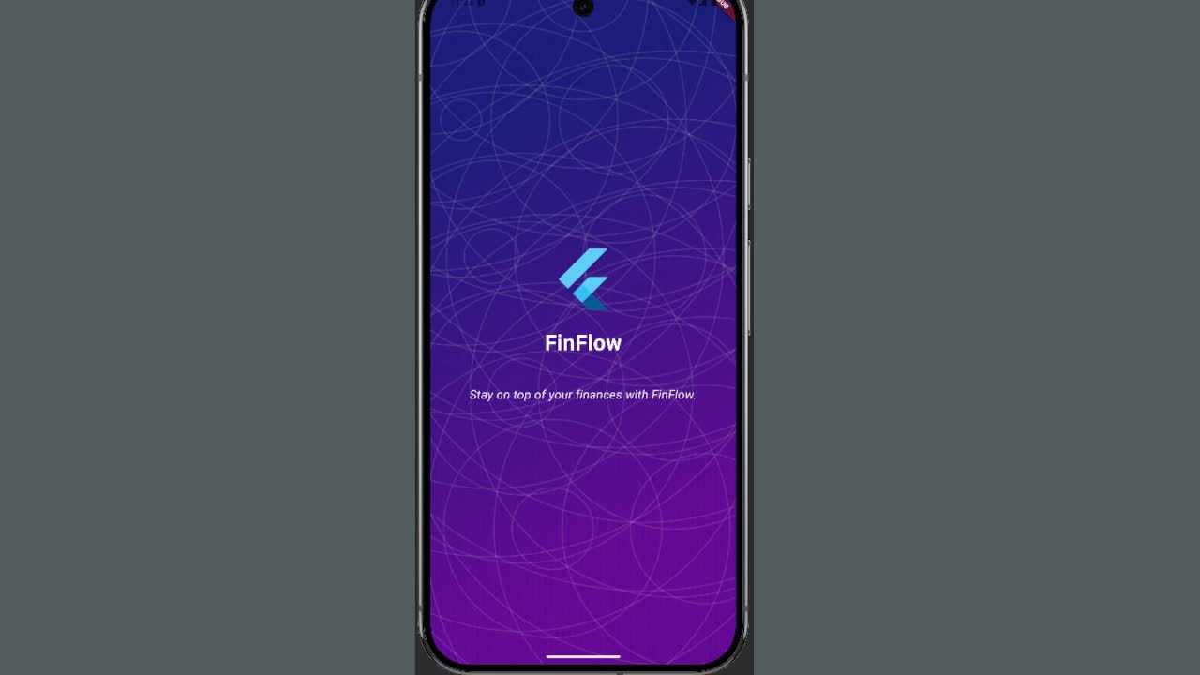
Live
Demo!

